Slide 1
Introduction to Machine Learning
CCS3102

Slide 2
This Week
Decision Trees
Overfitting
Hyper Parameter Tuning
Grid Search
Ensembling
Bagging
Boosting
Stacking
Practical Examples

Slide 3
Decision Trees
CART (Classification and Regression Trees)
A type of decision tree algorithm used for supervised machine learning tasks.
In more detail:
CART was introduced by Breiman et al. in 1986.
It’s a tree-based model that splits data into branches based on decision rules derived from feature values.
It can be used for both:
Classification (predicting a category/label)
Regression (predicting a continuous value)
How it works:
At each node, CART chooses a feature and a threshold that best splits the data using an impurity measure:
For classification: Gini impurity (commonly), or entropy.
For regression: Mean Squared Error (MSE).
The tree keeps splitting until a stopping criterion is met (like max depth, minimum samples per leaf, etc.).

Slide 4
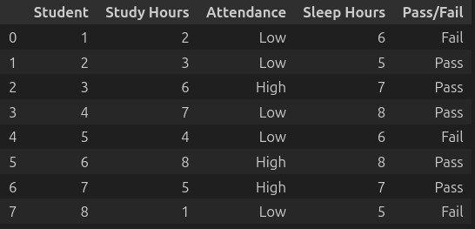
Decision Trees

Slide 5
Decision Trees
Splitting Conditions
How All Possible Conditions Are Gathered
For Numerical Features
Process: Sort all unique values and create thresholds between consecutive values.
Example: Feature "Age" with values [18, 22, 25, 30, 35]
Possible thresholds: 20, 23.5, 27.5, 32.5
Conditions generated:
Age ≤ 20
Age ≤ 23.5
Age ≤ 27.5
Age ≤ 32.5
Why these thresholds?: Any value between consecutive data points gives the same split, so we only need to test the midpoints.

Slide 6
Decision Trees
Splitting Conditions
How All Possible Conditions Are Gathered
For Categorical Features
Binary approach: For each unique value, create "belongs to subset" conditions.
Example: Feature "Color" with values [Red, Blue, Green, Yellow]
For binary trees, test each value individually:
Color = Red (vs. not Red)
Color = Blue (vs. not Blue)
Color = Green (vs. not Green)
Color = Yellow (vs. not Yellow)
Multi-way approach: Some algorithms allow multi-way splits creating one branch per category.

Slide 7
Decision Trees
Splitting Conditions
Generate All Possible Conditions
Study Hours (values: 1,2,3,4,5,6,7,8):
Study Hours ≤ 1.5
Study Hours ≤ 2.5
Study Hours ≤ 3.5
Study Hours ≤ 4.5
Study Hours ≤ 5.5
Study Hours ≤ 6.5
Study Hours ≤ 7.5
Attendance (values: Low, High):
Attendance = Low
Attendance = High
Sleep Hours (values: 5,6,7,8):
Sleep Hours ≤ 5.5
Sleep Hours ≤ 6.5
Sleep Hours ≤ 7.5

Slide 8
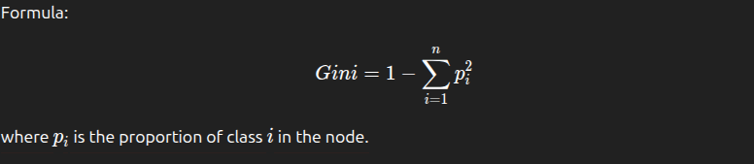
Decision Trees (Classification)
Gini Impurity
Measures how often a randomly chosen element from the set would be incorrectly labeled.
Example: 4 Pass, 4 Fail students
Initial Gini = 1 - (0.5² + 0.5²) = 1 - 0.5 = 0.5
Interpretation:
Gini = 0: Completely pure
Gini = 0.5: Maximum impurity for binary classification

Slide 9
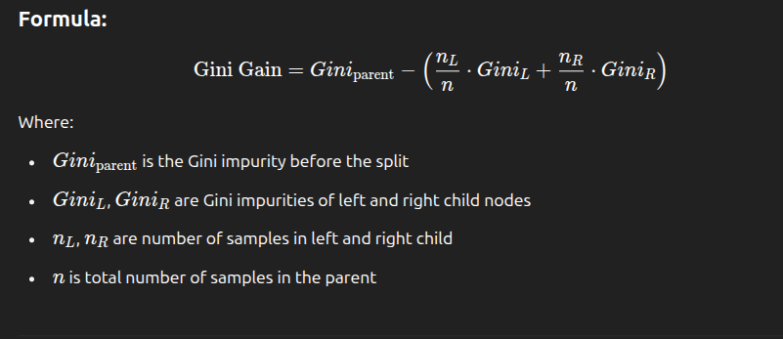
Decision Trees
Gini Gain (Information Gain when using Gini Impurity)
Measures the reduction in impurity after a dataset is split on a feature.
General Formula:
Gain = Impurity (parent) − Weighted average impurity (children)

Slide 10
Decision Trees
Calculate Gini & Gini Gain for (Study Hours ≤ 6.5)
Parent
Total Sample n = 8
No of Fail = 3
No of Pass = 5
Gini Parent = 1 - ( (3/8)² + (5/8)² ) = 1 - (0.140625 + 0.390625) = 0.469
Left Child
Total Sample n = 4
No of Fail = 3
No of Pass = 1
Gini Left = 1 - ( (3/4)² + (1/4)² ) = 0.375
Right Child
Total Sample n = 4
No of Fail = 0
No of Pass = 4
Gini Right = 1 - ( (0/4)² + (4/4)² ) = 0.0 (Pure, only contains samples with label pass)
Gini Gain = Gini Parent - sum (weighted gini of children) = 0.469 - [( (4/8) x 0.375 ) + ( (4/8) x 0.0 ) = 0.469 - 0.1875 = 0.2815

Slide 11
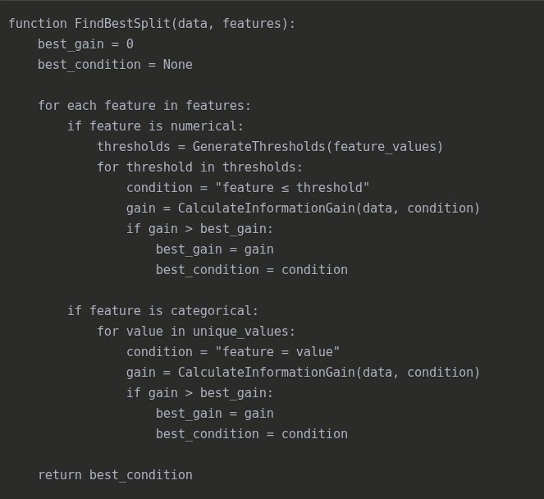
Decision Trees
Pseudo Code for finding best split

Slide 12
Decision Trees
Tie-Breaking Rules
When multiple conditions have the same gain, algorithms use tie-breaking rules:
Choose the condition that creates the most balanced split (closer to 50-50)
Prefer simpler conditions (fewer distinct values)
Use feature ordering (alphabetical or user-defined priority)
Random selection

Slide 13
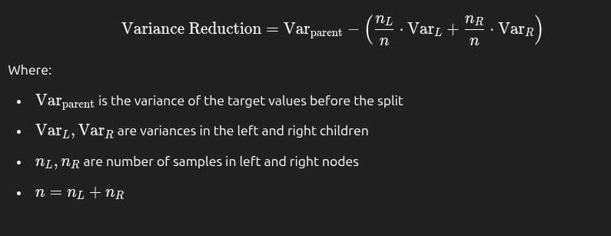
Decision Trees (Regression)
MAE (Mean Absolute Error)
In regression trees, the most common splitting criterion is reduction in variance (or Mean Squared Error minimization).
Choose splits that minimize the spread (variance) of target values within child nodes.
Just like classification uses:
Information Gain= Impurity Parent − sum(Weighted Impurity Children)
In Regression​
Variance Reduction = Variance Parent - sum(Weighted Variance Children)

Slide 14
Decision Trees
Why Overfitting Happens in Decision Trees
Trees Can Grow Too Deep
Decision trees can keep splitting the data until:
Each leaf contains only one sample, or
All samples in a leaf are perfectly pure
This leads to a model that fits the training data exactly, even memorizing random quirks, but performs poorly on new data.
📌 Analogy: It’s like writing an exam with every single example from the textbook memorized — even the typos — but not understanding the concepts.
Capturing Noise
When a tree grows deep, it may start to:
Make decisions based on irrelevant features
Model random fluctuations in the data
This causes the model to perform very well on training data, but poorly on test data — the textbook definition of overfitting.
No Regularization by Default
Unlike models like linear regression (which can use regularization like L1 or L2), a basic decision tree has no built-in control over:
How deep it grows
How many samples must be in a split
How complex its structure becomes
So unless you manually restrict it, it will keep growing.

Slide 15
Decision Trees
How to Prevent Overfitting
Limit tree depth (max_depth)
Set minimum samples for splits or leaves (min_samples_split, min_samples_leaf)
Prune the tree after it’s built (remove weak branches)
Use ensemble methods like:
Random Forests (many trees with averaging)
Gradient Boosting (builds trees sequentially with regularization)

Slide 16
Hyper Parameter Tuning
What is hyperparameter?
A hyperparameter is a setting you define before training a model, which controls the training process or model structure.
They’re not learned from the data — instead, you choose and tune them.
Why is Hyperparameter Tuning Important?
The right combination can drastically improve model performance.
Bad settings can lead to underfitting or overfitting.
When to do Hyperparameter Tuning?
Always perform it:
After basic preprocessing.
Before model evaluation on test se.
During cross-validation, to avoid data leakage. (HP Tuning should be done inside cross validation loop, not on whole training data).
Same rule applies when:
Scaling data
Feature selection
PCA
Imputation

Slide 17
Hyper Parameter Tuning
How to Do Hyperparameter Tuning?
Manual Search
Grid Search
Random Search (aka Randomized Grid Search)
Bayesian Optimization / Advanced Methods
Eg: Hyperopt, Optuna

Slide 18
Hyper Parameter Tuning
Grid Search
Try all possible combination of Hyperparameter Specified to select best set of Hyperparameters based on model performance.
Example:
You have a training dataset X_train of 100 samples
You use cv=5 (5-fold cross-validation)
{'max_depth': [3, 5, 10], 'min_samples_split': [2, 5]}
Possible combinations: 6
Pseudo Code
For each hyperparameter combination:
Split the data into 5 folds.
For each fold:
Train the model on 80 samples (4 folds)
Validate the model on 20 samples (1 fold)
Average the 5 validation scores → this is the score for that combination.
You end up training 5 × 6 = 30 models just during tuning.

Slide 19
Ensembling
“Many weak models combined can make a strong model.”
Ensembling is a technique in machine learning where multiple models (often called base learners) are combined to improve overall performance compared to a single model.
There are three different types of Ensembling
Bagging Ensemble
Boosting Ensemble
Stacking Ensemble

Slide 20
Ensembling
Bagging Ensemble (Bootstrap Aggregating)
Models are trained independently on random subsets of data (with replacement).
Final prediction is made by averaging (regression) or voting (classification).
Example: Random Forest
S1
M1
Train Data
S2
M2
Aggregation
(i.e vote/sum/avg)
S3
M3
S - Subset of train data
M - Base/Weak Model
S4
M4

Slide 21
Ensembling
Boosting Ensemble
Models are trained sequentially, each trying to fix the errors of the previous one.
Example: XGBoost, LightGBM, AdaBoost
M1
Train Data
M2
Aggregation
(i.e vote/sum/avg)
M3
M - Base/Weak Model
M4

Slide 22
Ensembling
Boosting Ensemble
What Changes Between Learners?
Changes Sample Weights
Initially, every training sample is equally weighted.
After training the first weak model (say, a small decision tree), some samples are misclassified.
Increases the weight of misclassified samples.
Decreases the weight of correctly classified samples.
So the next model pays more attention to the "hard" examples.
📌 Think of it like a teacher spending more time with students who got the last quiz wrong.
Eg: Adaboost
Focuses on Residual Errors
The model is trained to predict what the last model missed.
Instead of weighting samples, it models the errors (residuals) made by the previous learner.
The next model is trained to predict these residuals.
Then we add those predictions to improve accuracy.
📌 So each new model focuses on the parts the previous model got wrong, Like an artist adding layers of detail to a painting.
Eg: Gradient Boosting

Slide 23
Ensembling
Stacking Ensemble
Combines multiple different models (logistic regression, SVM, etc.) and uses another model to learn how to best combine their predictions.
S1
M1
Train Data
S2
M2
Meta Model
S3
M3
S4
M4

